Slide 1
Synthetic Satellite Discontinuity Tests
Katia 12L 2011090100
Igor 11L 2010090812

Slide 2
For images with 3km nest included:
3km grid (d03) is plotted on top of the combined domain
Note: If you plot only the combined domain, it looks almost the same, only the resolution changes, resulting in minor differences
For images with no 3km nest:
9km grid (d02) is plotted by itself (intermediate nest)
“Before and after” images are always from the same run of the model

Slide 3
Samples of the discontinuity from H212
Katia 12L 2011090100
Igor 11L 2010090812

Slide 4
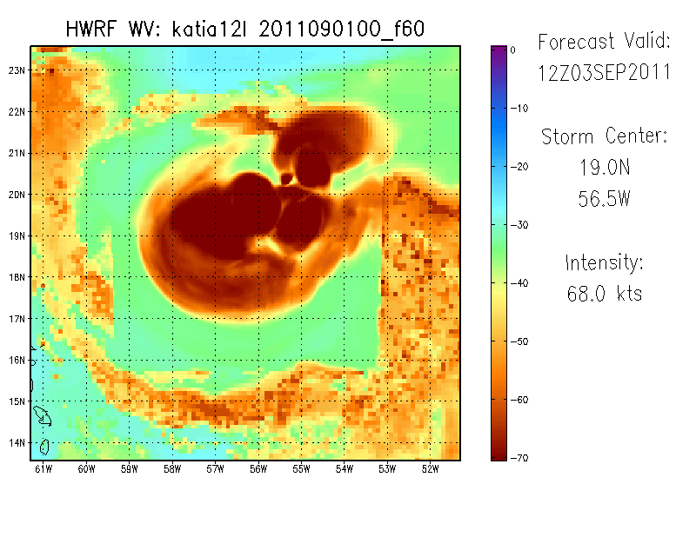
With 3 km nest: Water Vapor
Examples of a forecast from Katia. The black box roughly outlines the location of the nest. Notice that the convective blob on the northern edge of the 3km seems to extend into the parent domain, however the bands located in d02 to the west and south of d03 disappear once they reach the nest.

Slide 5
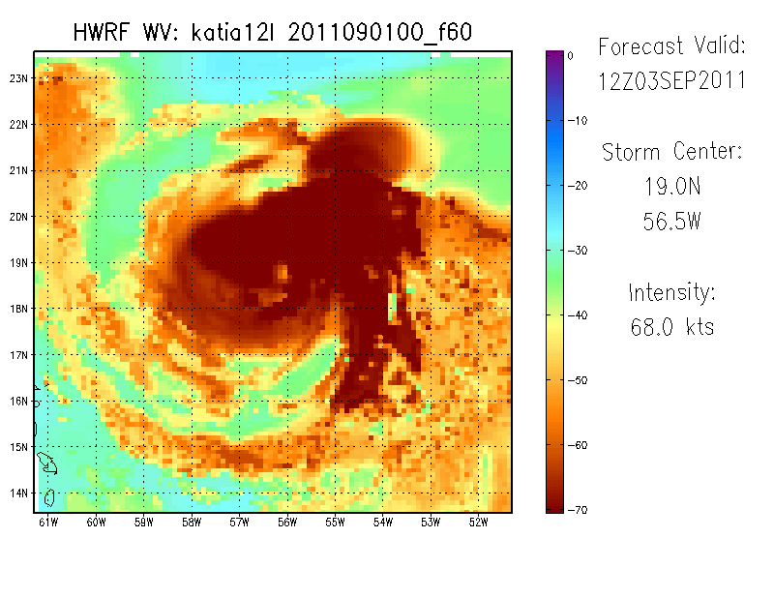
3km nest removed: Water Vapor
By removing the nest, the discontinuities disappear. Interestingly, any features that were located in d03 also appear in d02, including the blob located along the northern edge of the nest. The brightness temperature appears to show the combined effects of the nest plus the parent domain. This means that areas that were “cloudy” in d03, still appear cloudy here. However, locations that were clear in d03 are now also “cloudy”.

Slide 6
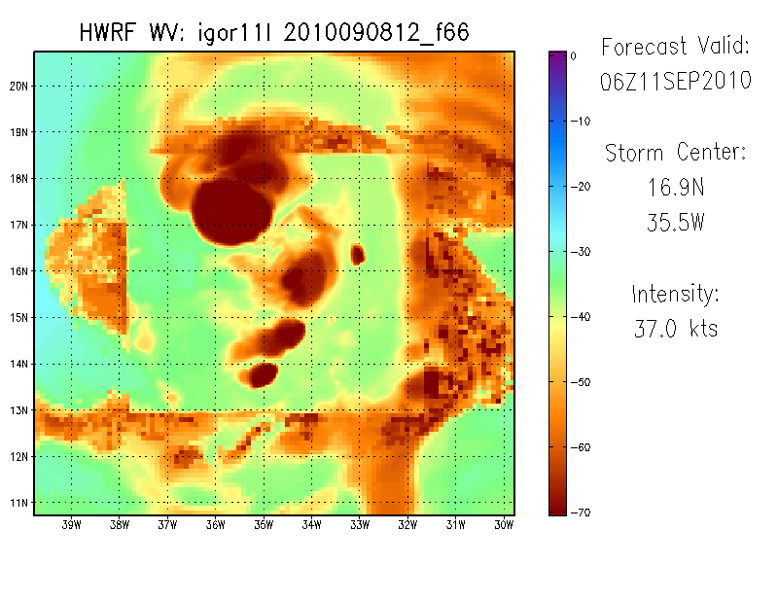
With 3 km nest: Water Vapor
Another example, this time from a forecast of Igor. Once again, features originating in the nest that occur near boundary seem to continue into d02, however any feature beginning in d02 is prevented from entering d03.

Slide 7
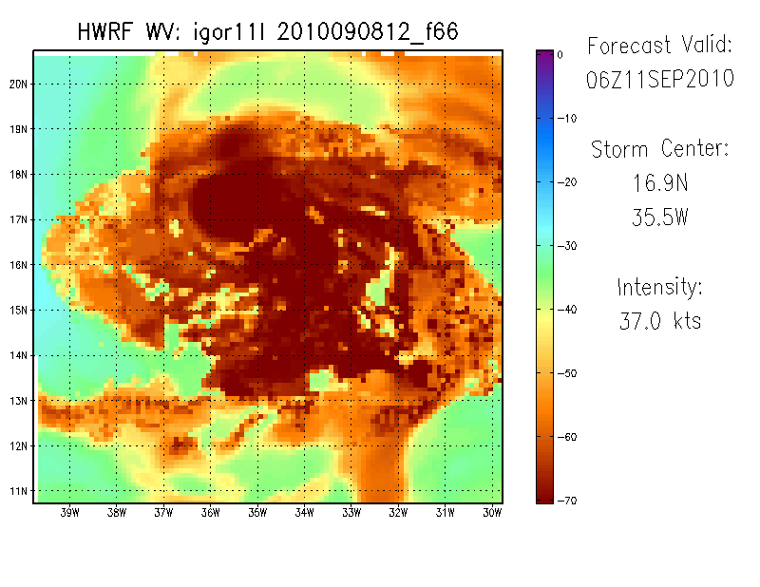
3km nest removed: Water Vapor
Once again, the d02 plot shows the combined clouds of d02 and d03. Another way to think of it is: for a given pixel, the Tb in the d02 version of the storm is never warmer than it was in the d03 version.

Slide 8
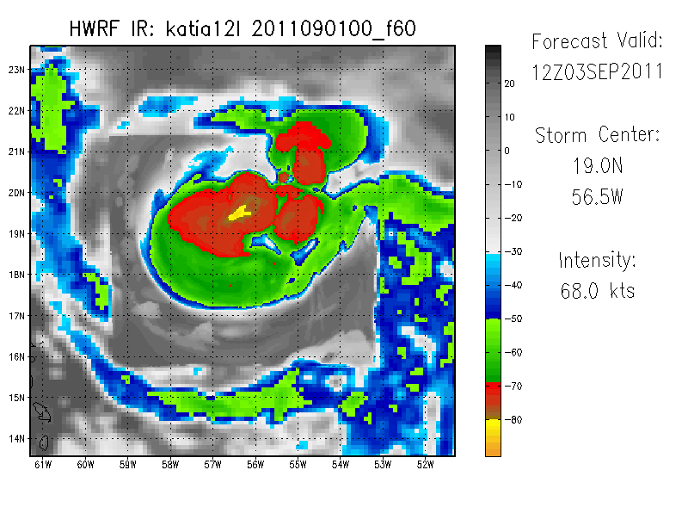
With 3 km nest: Channel 4 IR
Continued examples, now with IR. The behavior is the same as the WV.

Slide 9
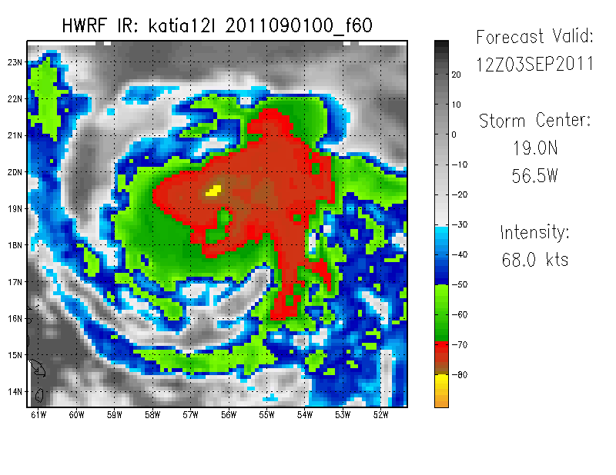
3km nest removed: Channel 4 IR
Continued examples, now with IR. Once again, the brightness temperature is roughly the same as d03, plus an added component. For a given pixel, some minor differences may be visible (where a cold cloud top in d03 is slightly warmer in d02), however this is likely a result of the resolution differences.

Slide 10
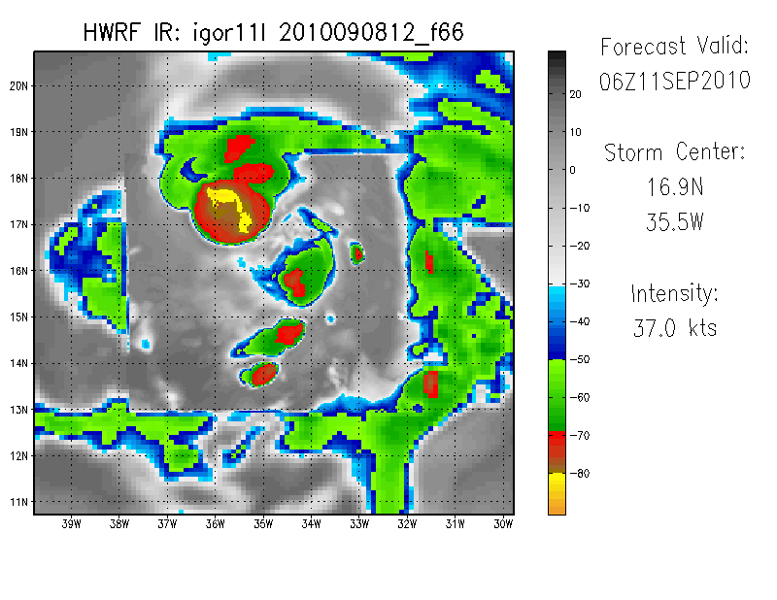
With 3 km nest: Channel 4 IR
Another example, d03 for Igor

Slide 11
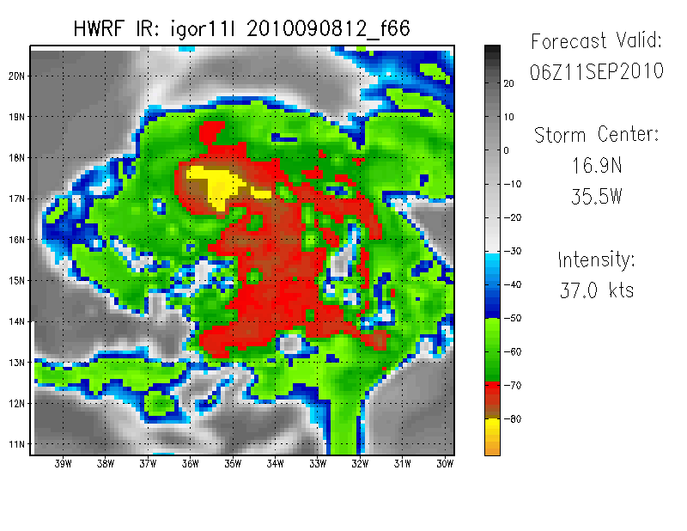
3km nest removed: Channel 4 IR
Another example, d03 removed for Igor

Slide 12
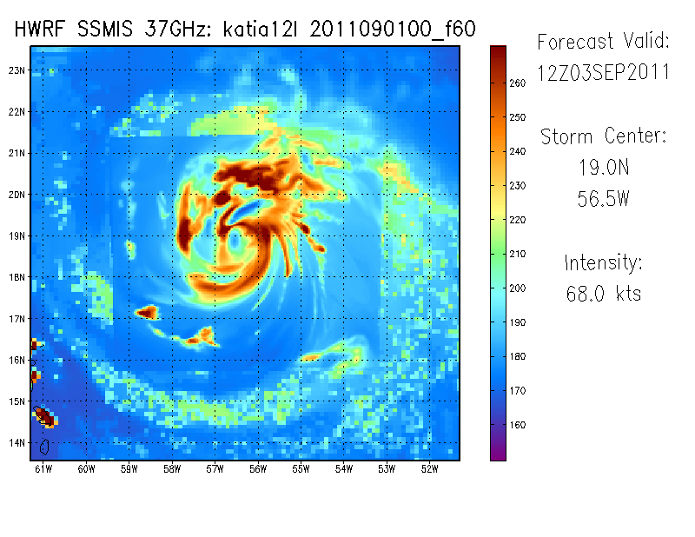
With 3 km nest: 37 GHz Horizontal Polarization
The microwave is not as discontinuous. There are probably a few reasons for this. Tropical cyclones often don’t have a strong microwave signal outside of nest, so there may not be as much opportunity for discontinuities. Additionally, the GOES parameters are cloud-top based, while microwave looks at a large depth of the troposphere. It is possible that the primary differences occur with cloud tops.

Slide 13
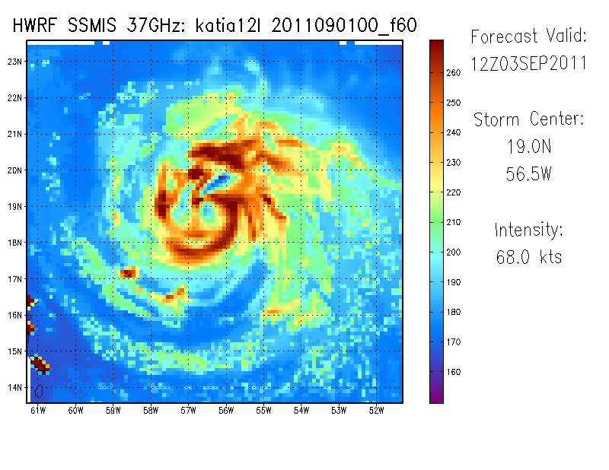
3 km nest removed: 37 GHz Horizontal Polarization
Some differences are still present. Some of this is almost certainly related to resolution. That said, within the nest there is still some discrepancy as to what the low/mid level cloud and precipitation field should look like, especially along the eastern boundary of where d03 would be located.

Slide 14
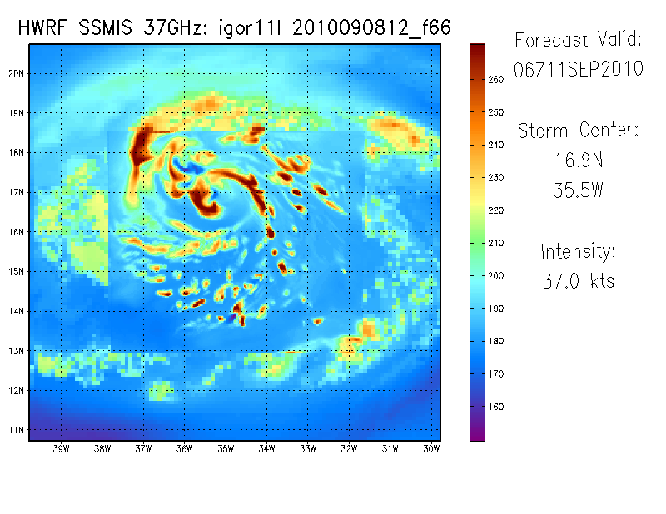
With 3 km nest: 37 GHz Horizontal Polarization
The microwave for Igor shows a similar story. Some discontinuity is present, however it is not nearly as obvious as the GOES imagery.

Slide 15
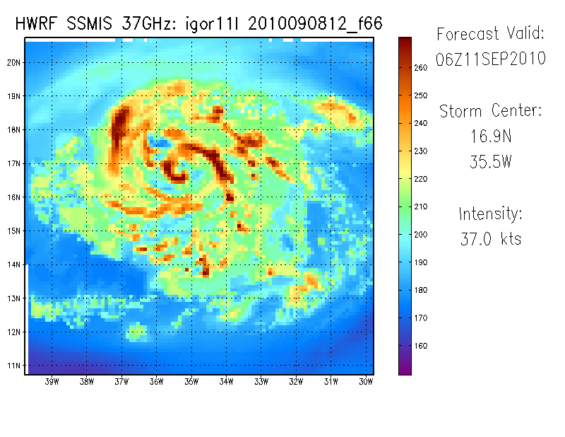
3 km nest removed: 37 GHz Horizontal Polarization
Again, differences in the d03 region are heavily influenced by resolution differences. That said, resolution likely can not account for all of the differences by itself.

Slide 16
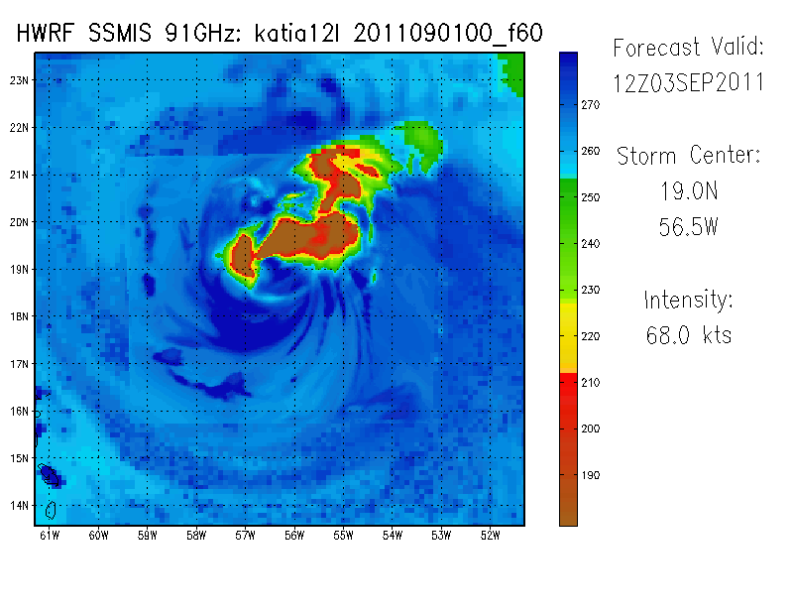
With 3 km nest: 91 GHz Horizontal Polarization
Finally, the 91GHz field shows very little in the way of discontinuities. The 91GHz channel is going to be responsive to deep convection, so this is not surprising since deep convection will typically primarily occur within a few degrees of the center. It will be interesting to see what happens in a case where a tropical cyclone is interacting with some other feature, like a front, which also has its own deep convection. A very large storm could also show some discontinuities in the 91GHz imagery.

Slide 17
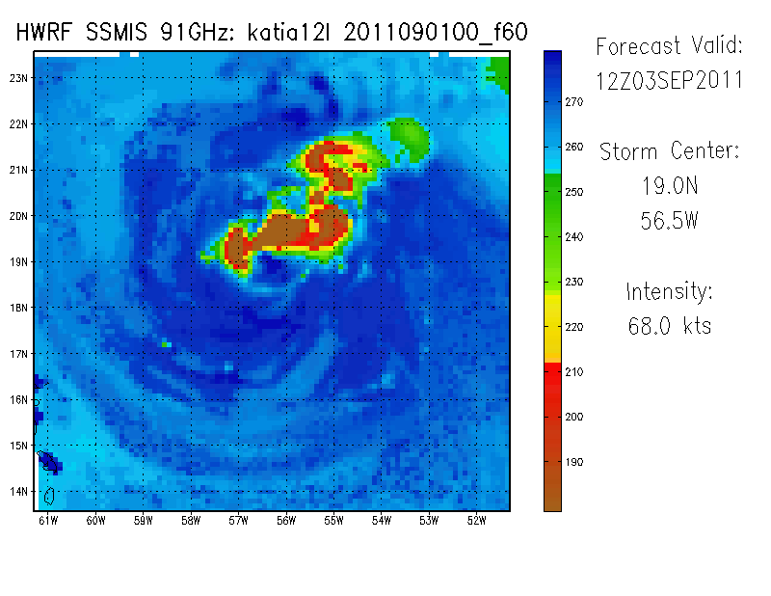
3 km nest removed: 91 GHz Horizontal Polarization
Looks almost the same, just with a lower resolution.

Slide 18
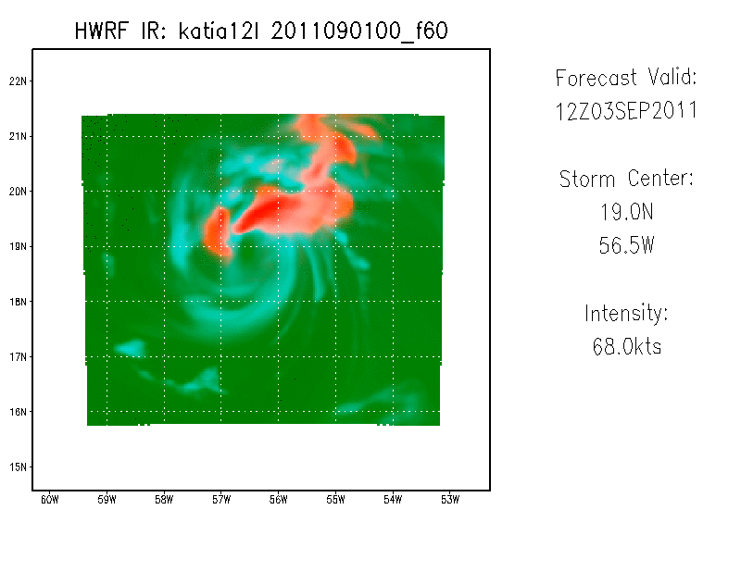
37 GHz Color Composite: nest
One possible solution for solving the discontinuity issue is through the use of microwave color composites. The 91GHz and 37GHz composites are very consistent between the 3km and 9km domains. The color composites are not as sensitive to some of the minor differences between the domains, resulting in very similar structures. The only obvious difference between the d03 and d02 versions of the next few images is the resolution.

Slide 19
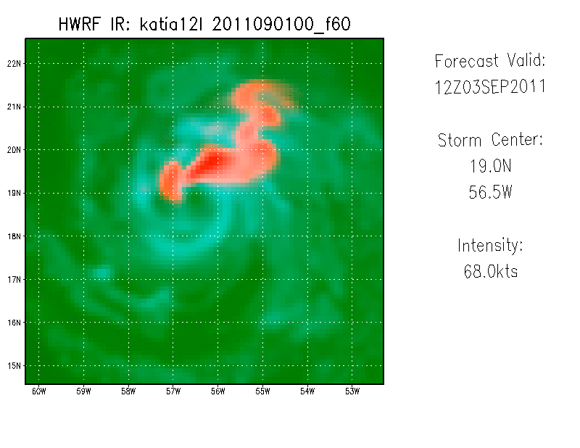
37 GHz Color Composite: nest removed

Slide 20
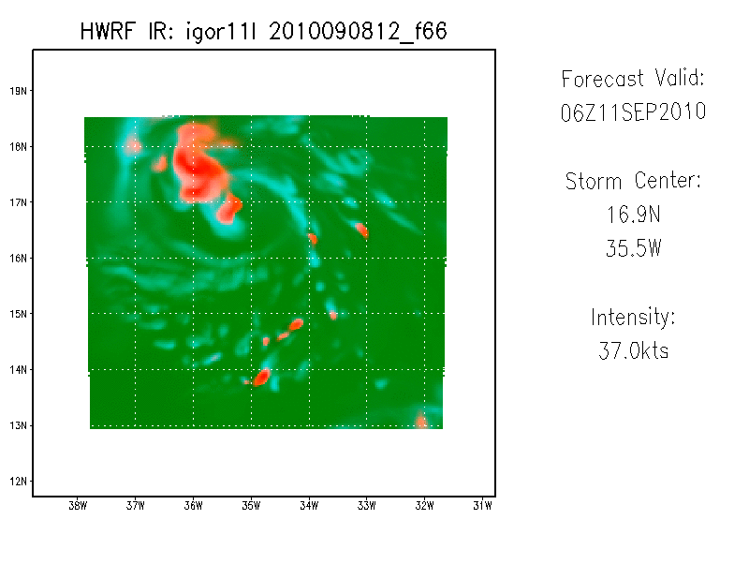
37 GHz Color Composite: nest

Slide 21
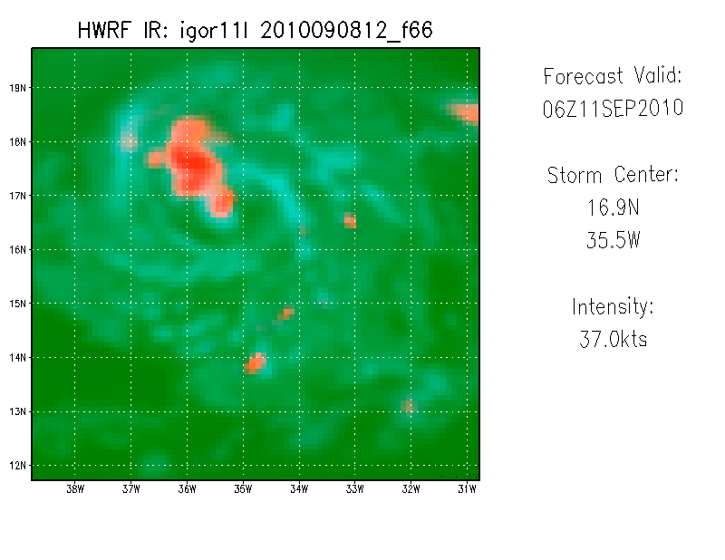
37 GHz Color Composite: nest removed

Slide 22
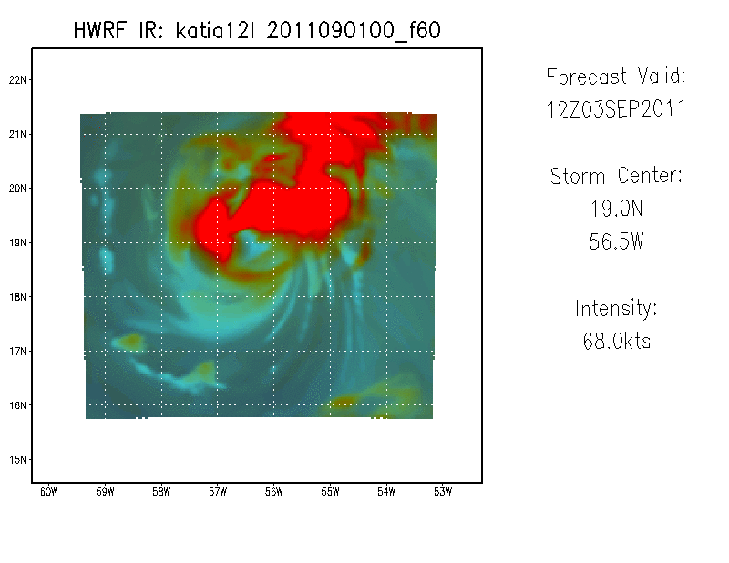
91 GHz Color Composite: nest
The same is true for the 91GHz channel. The color composites are not as sensitive to the differences.

Slide 23
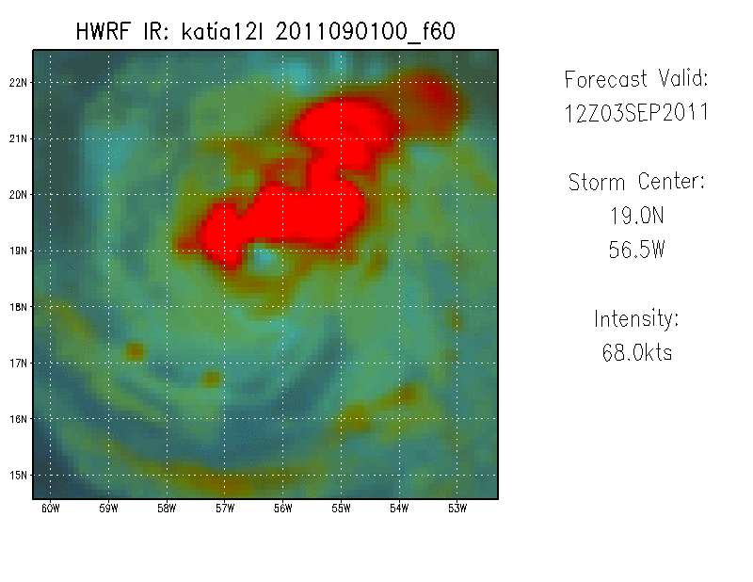
91 GHz Color Composite: nest removed

Slide 24
Experiments
The next set of slides show examples from reruns of the Katia and Igor forecasts.
Two experiments were computed.
One with SAS turned on in d03
One with a 15s physics time step used
For a given product, the first slide includes the 3km nest (d03), the 2nd slide shows only the 9km domain (d02)

Slide 25
Microphysics Tests Left: SAS turned on Right: 15s physics time-step
Igor 11L 2010090812

Slide 26
With 3km nest: Water Vapor
SAS turned on in d03
15s physics calls

Slide 27
3km nest removed: Water Vapor
SAS turned on in d03
15s physics calls
The version with SAS turned on in d03 removes the discontinuity almost completely. At certain times during the forecast, small discontinuities can still be seen, however overall the fields are essentially continuous. On the other hand, the run with 15s physics calls still has the discontinuity. In fact, the run with the 15-s physics time step is more intense than the control, but otherwise behaves very similarly.

Slide 28
With 3km nest: Channel 4 IR
SAS turned on in d03
15s physics calls

Slide 29
3km nest removed: Channel 4 IR
SAS turned on in d03
15s physics calls
Again, the version with SAS turned on in d03 has no discontinuity, while the version with 15-s physics calls still has one.

Slide 30
With 3km nest: 37 GHz Horizontal Polarization
SAS turned on in d03
15s physics calls

Slide 31
3 km nest removed: 37 GHz Horizontal Polarization
SAS turned on in d03
15s physics calls
The SAS-turned-on run also is very continuous in the 37GHz microwave, while the 15s time-step physics still has discontinuities. Interestingly, while the 15s physics calls has not removed the discontinuity, it has had a large impact on the structure of the storm. In the control (see slide 14) rainbands and thunderstorms appear somewhat smoothed. In the 15-s version, these features are very pixilated. It is almost as if the 15s timestep has unrealistically reduced the size of convective elements, reducing them from several grid points to one or two. On the contrary, the SAS run and the control seem more physically reasonable. That said, it is difficult to determine which is more physically reasonable because observations of real TCs at 37GHz are typically at resolutions of 15-30km.
Notes:
The SAS-turned-on run also is very continuous in the 37GHz microwave, while the 15s time-step physics still has discontinuities. Interestingly, while the 15s physics calls has not removed the discontinuity, it has had a large impact on the structure of the storm. In the control (see slide 13) rainbands and thunderstorms appear somewhat smoothed. In the 15-s version, these features are very pixilated. It is almost as if the 15s timestep has unrealistically reduced the size of convective elements, reducing them from several grid points to one or two. On the contrary, the SAS run and the control seem more physically reasonable. That said, it is difficult to determine which is more physically reasonable because observations of real TCs at 37GHz are typically at resolutions of 15-30km.

Slide 32
With 3 km nest: 37 GHz Composite
SAS turned on in d03
15s physics calls

Slide 33
3 km nest removed: 37 GHz Composite
SAS turned on in d03
15s physics calls
The 37GHz composite is again shown to be less sensitive to differences between the d02 and d03 microwave images. Even the 15s physics call run is smoothed out in the composite, and appears relatively less pixilated.

Slide 34
Microphysics Tests Left: SAS turned on Right: 15s physics time-step
Katia 12L 2011090100

Slide 35
With 3km nest: Water Vapor
SAS turned on in d03
15s physics calls

Slide 36
3km nest removed: Water Vapor
SAS turned on in d03
15s physics calls
The same results can be said about the Katia run. The run with SAS turned on in d03 effectively removes the discontinuities, while the run with 15s physics calls does not.

Slide 37
With 3km nest: Channel 4 IR
SAS turned on in d03
15s physics calls

Slide 38
3km nest removed: Channel 4 IR
SAS turned on in d03
15s physics calls

Slide 39
With 3km nest: 37 GHz Horizontal Polarization
SAS turned on in d03
15s physics calls
The 15s time step again results in smaller, skinnier features. On the other hand, the SAS run looks more physically realistic.

Slide 40
3 km nest removed: 37 GHz Horizontal Polarization
SAS turned on in d03
15s physics calls

Slide 41
With 3 km nest: 37 GHz Composite
SAS turned on in d03
15s physics calls

Slide 42
3 km nest removed: 37 GHz Composite
SAS turned on in d03
15s physics calls

Slide 43
Summary
The discontinuity is primarily present in cloud top products, and in low to mid level, relatively shallow, convection (37GHz).
Turning SAS on in d03 removes the discontinuity.
This allows the storm to represent outflow cirrus and the relatively weak banding features near the d03 boundaries in a way that is consistent with d02.
It is unknown whether this improves or degrades the representation of those features
Using a 15-s physics time step does not remove the discontinuity.
The 15-s physics time step results in convective features that may be unrealistically small
Side note: for both Igor and Katia, both experimental runs resulted in hurricanes with larger eye features than the control (H212).

